Slide 1
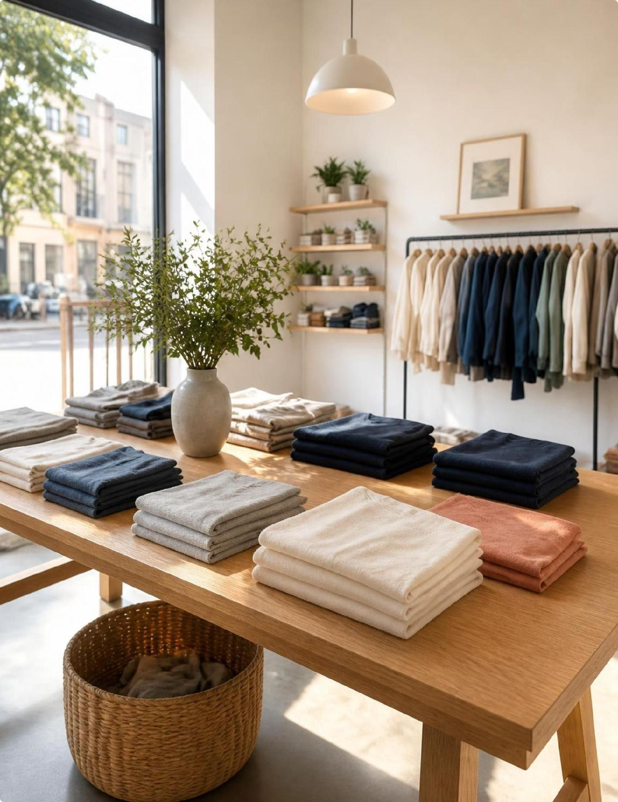
CUSTOMER SHOPPING BEHAVIOR ANALYSIS
What 3,900 purchases tell us about our customers
A data-driven baseline of purchasing habits, category winners, and margin opportunities across 3,900 verified transactions.
Notes:
Welcome everyone. Today we are walking through the core patterns behind 3,900 purchases: who buys, what they spend, and where we can capture immediate margin.

Slide 2
BASELINE TRANSACTION ECONOMICS
A loyal base that spends about $60 an order
$59.76
3.75 / 5
3,116
Average purchase value across all 3,900 transactions analyzed.
Average review rating, indicating consistent customer satisfaction.
Loyal repeat buyers, alongside 701 returning and just 83 first-time shoppers.
Key takeaway: 80% of our buyers are already loyal, giving us a dependable floor of repeat revenue.
Notes:
Three numbers establish our baseline. Basket size is predictable at sixty dollars, and the customer file is overwhelmingly loyal rather than top-of-funnel.

Slide 3
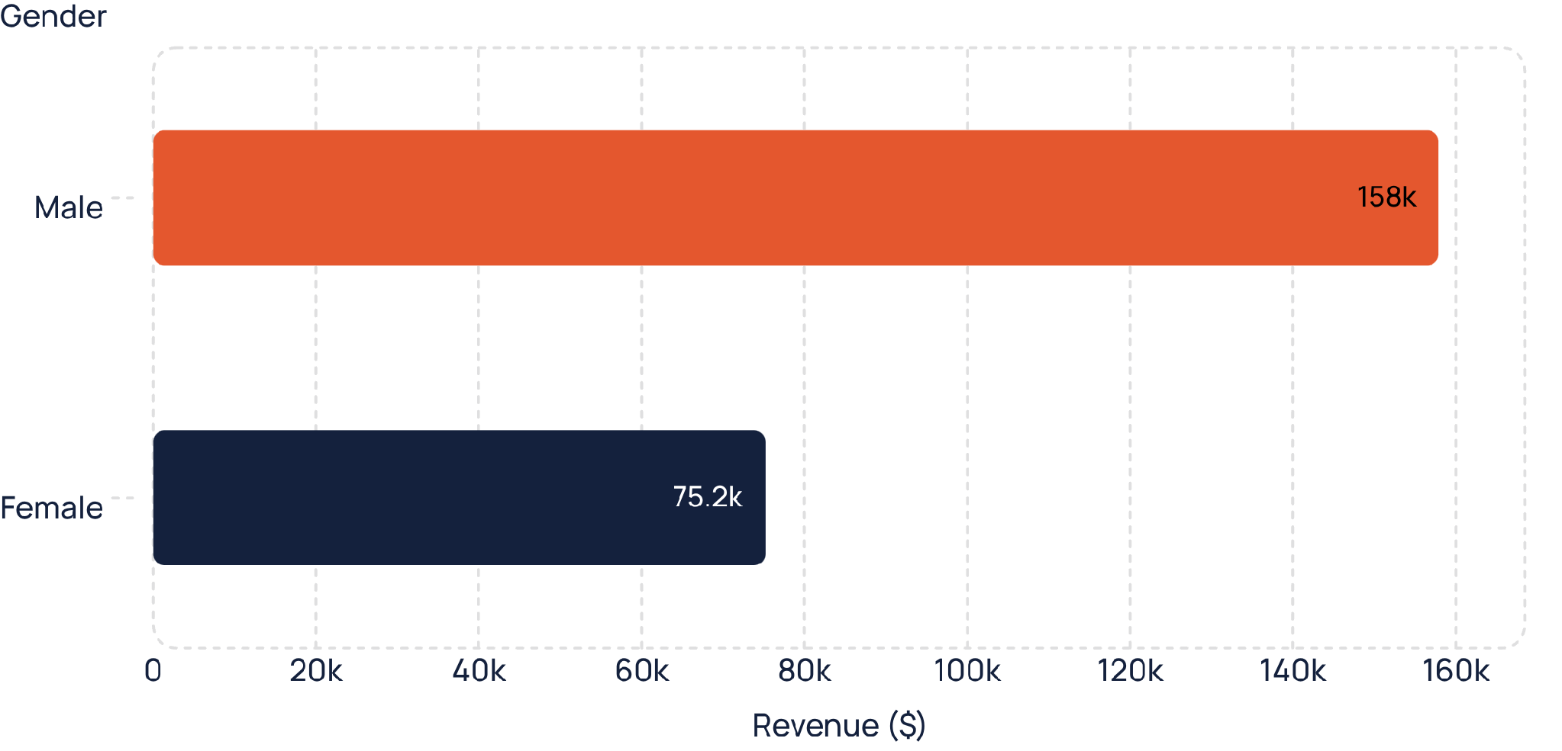
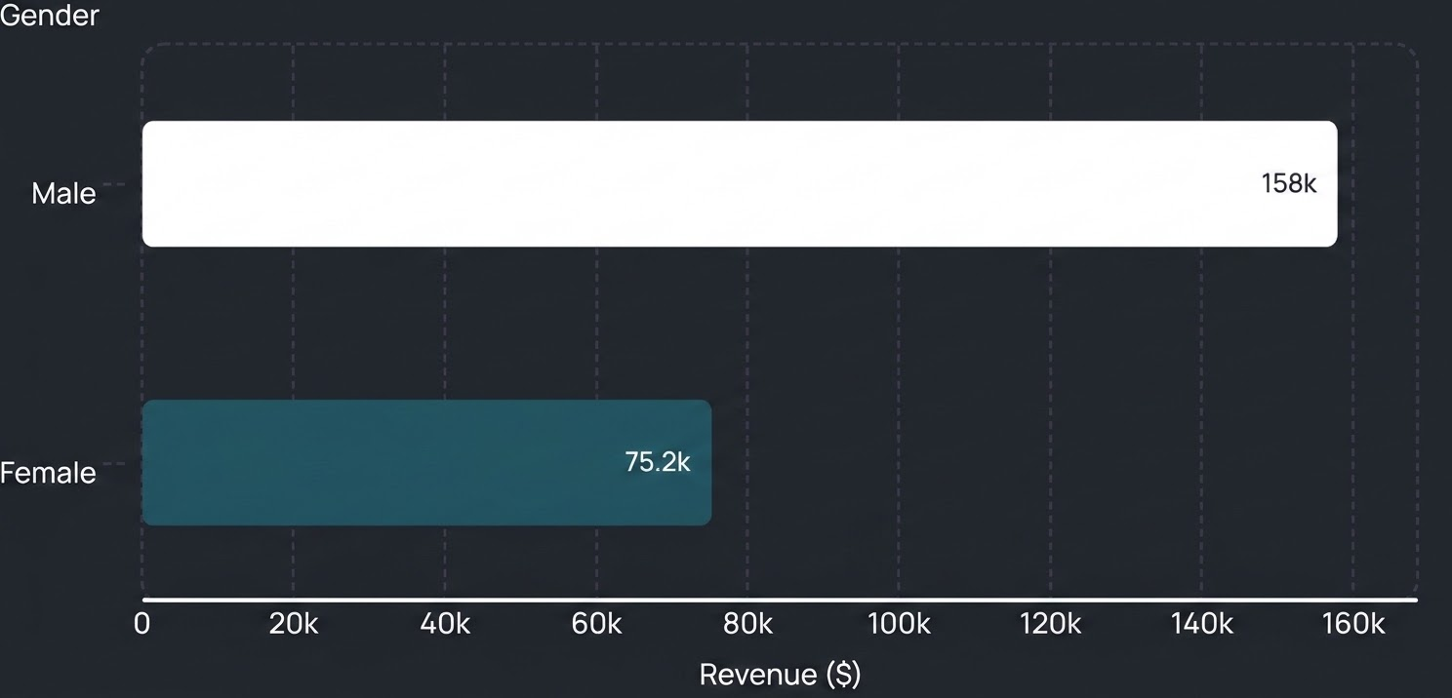
AUDIENCE CONTRIBUTION
Male customers generate about two-thirds of revenue
68%
$157,890 from male buyers
Male shoppers generate more than double the revenue of female shoppers ($75,191), making men our primary buyer volume today.
Total gross revenue tracked across 3,900 customer transactions.
Notes:
Male buyers account for over two-thirds of total gross sales. Our marketing and assortment should lean into this strength while identifying why female conversion lags.

Slide 4
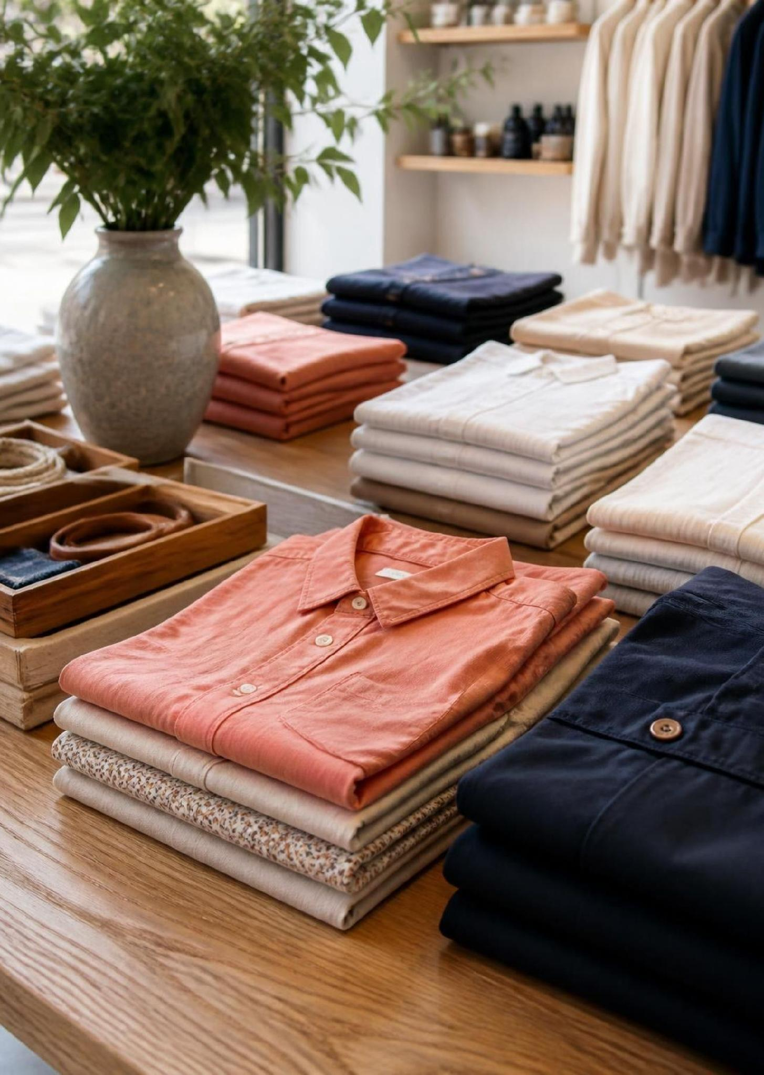
MERCHANDISE BREAKDOWN
Clothing leads the catalog, but every category has a hero
Clothing · 1,737 purchases
Blouse and Pants lead basket additions across seasons.
Category heroes
Jewelry leads accessories, Sandals footwear, and Jacket outerwear revenue.
Customer favorites · Rated ~3.8 / 5
Gloves, Sandals and Boots have the highest ratings and can drive retention.
Notes:
Clothing carries over forty percent of transactions, but every segment has a reliable hero item. The highest rated products are functional footwear and outerwear.

Slide 5
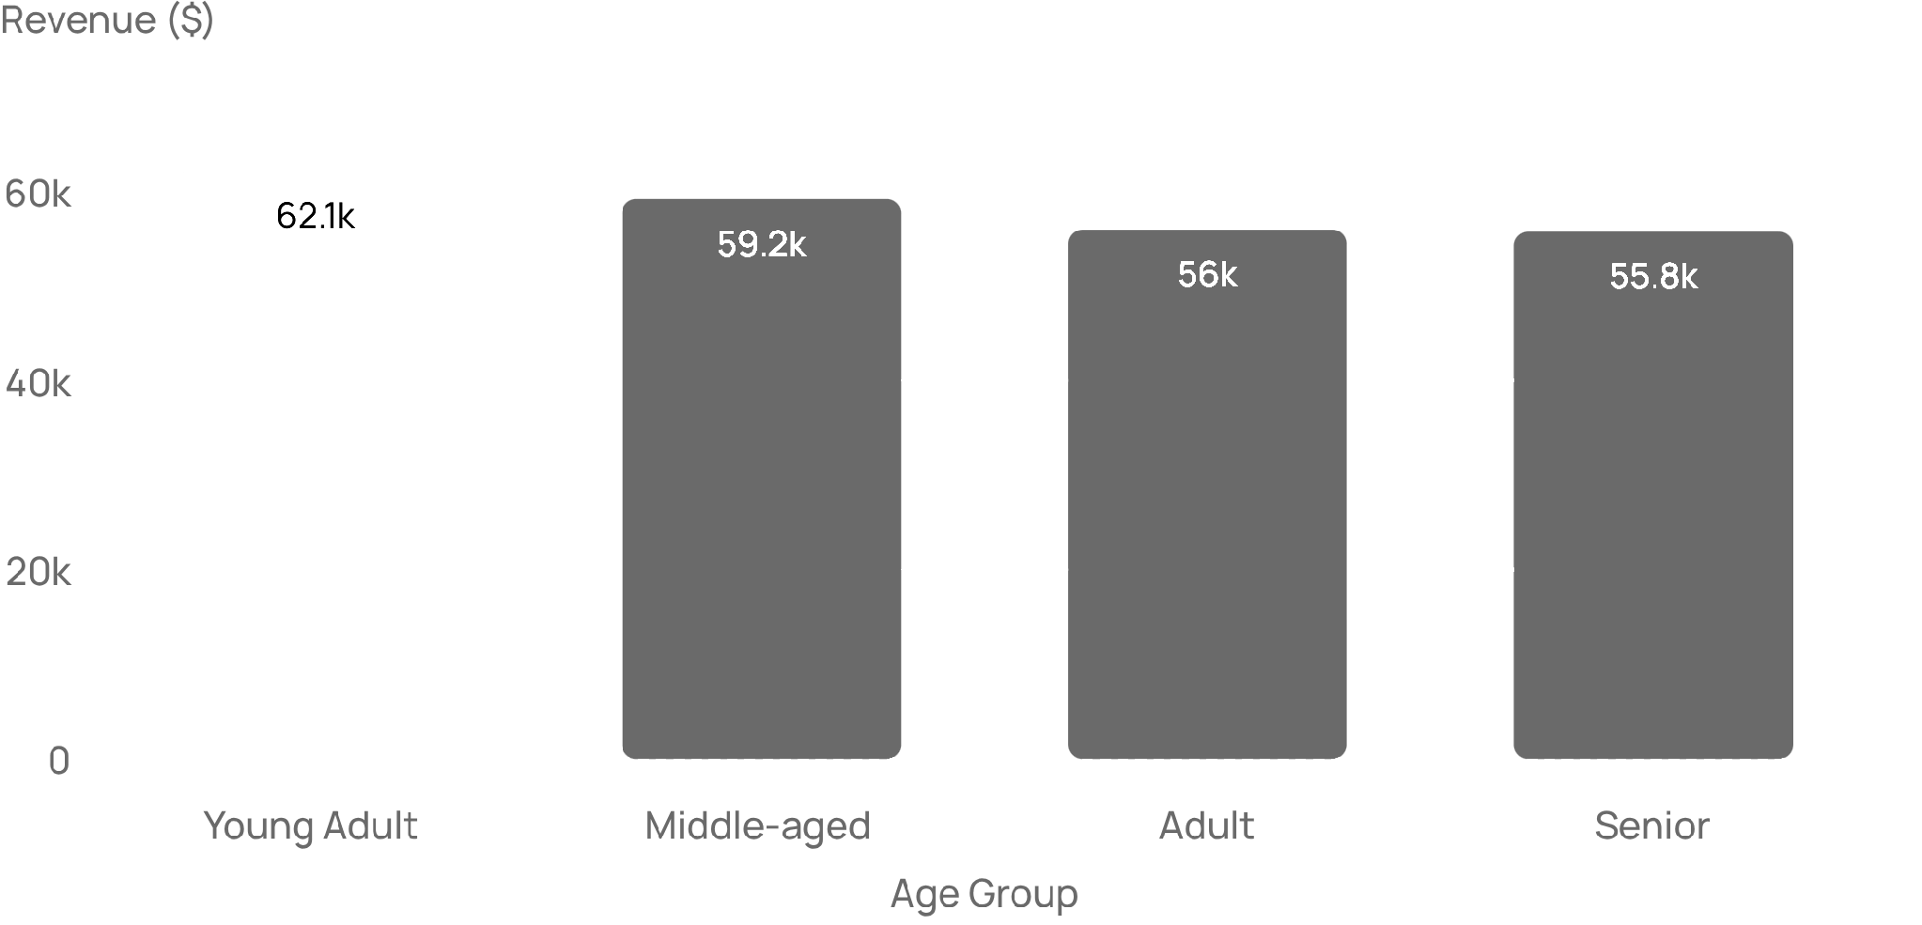
DEMOGRAPHIC DISTRIBUTION
Revenue is spread evenly across age groups
~10%
Narrow spread across ages
Young adults lead at $62,143, while seniors trail at $55,763. Broad demographic appeal means we don't rely on a single age bracket.
Revenue distribution across four defined customer life stages.
Notes:
Revenue doesn't drop off with age. The gap between our highest and lowest performing cohorts is only about ten percent, proving broad multi-generational appeal.

Slide 6
SUBSCRIPTION PERFORMANCE
Subscribers are scarce, and they don't spend more
ADOPTION RATE
AVERAGE ORDER VALUE
27%
$59.49 vs $59.87
Subscribers spend −$0.38 less per order than non-subscribers: no basket premium.
1,053 of 3,900 subscribe
Nearly three out of four customers purchase without joining.
REPEAT BUYER GAP
Among buyers with more than 5 purchases, 2,518 don't subscribe and 958 do.
Takeaway: The current subscription lacks meaningful incentives for our most active buyers.
Notes:
This is a critical finding. Our subscription program is under-indexed and offers no basket expansion. Over 2,500 highly loyal buyers have zero incentive to sign up.

Slide 7
PRICING & FULFILLMENT LEVERS
Discounts and express shipping both lift sales
PROMOTIONAL ELASTICITY
SHIPPING TIER IMPACT
839
+$2.02
Discount users spent above average
$60.48 Express vs $58.46 Standard
Hats, sneakers and coats see roughly 50% discount penetration, stimulating high conversion without eroding order value.
Higher Express baskets show speed-sensitive shoppers are willing to spend more per checkout.
Promotions preserve margins; premium shipping attracts higher spenders.
Notes:
Promotions and delivery speed both provide clear pricing power. Discount users still exceeded the sixty-dollar average, and express fulfillment correlates with larger baskets.

Slide 8
EXECUTIVE ACTION PLAN
Five moves to grow revenue and protect margin
01
Rebuild subscriptions: Offer members-only perks and tiered discounts to our 2,500+ repeat buyers.
02
Formalize loyalty: Give our 3,116-strong loyal core milestone perks to drive frequency and basket size.
03
Calibrate discounts: Protect margin by tightening promotions on high-demand staples and testing bundles on price-elastic goods.
04
Spotlight heroes: Feature Blouses, Pants, and top-rated Boots and Gloves in cross-sell campaigns.
05
Target high-yield buyers: Prioritize young adults and upsell express shipping at checkout to lift average order value.
Strategic priority: Capitalize on customer loyalty while revamping subscription economics.
Notes:
To summarize: we don't have an acquisition problem; we have an optimization opportunity. Strengthening subscriptions and loyalty rewards will compound our existing customer base.

